Slide 1


Interpreting Deep Sports Analytics: Valuing Actions and Players in the NHL
Guiliang Liu, Wang Zhu, Oliver Schulte
Machine Learning Lab
Notes:
Hello everyone…

Slide 2
Problem
Understand the Deep Reinforcement Learning (DRL) Model in National Hockey League (NHL)
Notes:
1. Our purpose is to solve the problem of understanding the DRL Model in NHL.
2. Our another contribution is to find exceptional players in the ranking list (interesting work).

Slide 3
DRL Model: Previous Work
Liu and Schulte IJCAI 2018
Notes:
Our work is based on the previous work of Liu and Schulte IJCAI 2018.

Slide 4
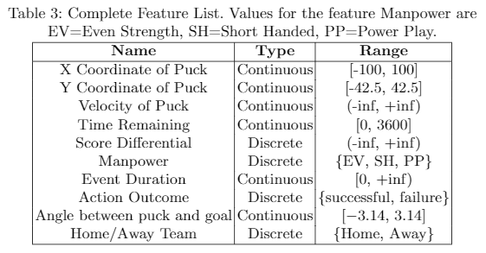
Dataset
Game events and player actions for the 2015-2016 NHL season.
Augment the data with derived features (red lines).
Divide NHL games into goal-scoring episodes that
Begin at the beginning of the game, or after a goal.
Terminate with a goal, or the end of the game.
Notes:
We use data from 2015-2016 NHL reason.
The original data doesn’t have enough information for training, so we augment the data with some derived features marked in red lines (velocity, time remaining, etc.)
Also, goal-scoring episodes…

Slide 5
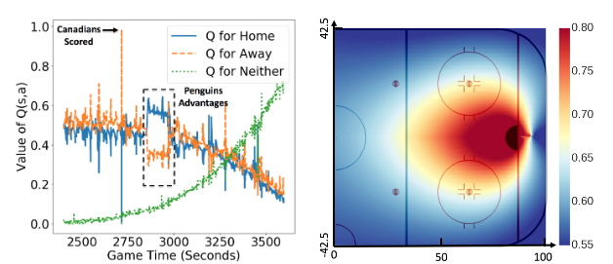
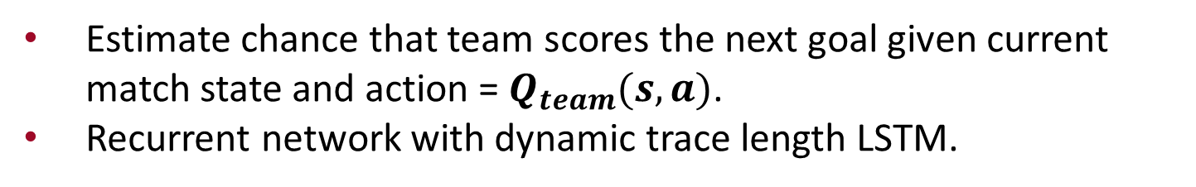
DRL Model
Estimate chance that team scores the next goal given current match state and action = $Q_{team}(s,a)$.
Recurrent network with dynamic trace length LSTM.
Temporal Projection: evolution of scoring probabilities for the next goal
Spatial Projection (for shot): The probability that the home team scores the next goal after taking a shot at a rink location
Notes:
Temporal Projection: “including the chance that neither team scores another goal”, Q_end
Spatial Projection: “averaged over possible game states”

Slide 6
Goal Impact Metric
$Impact(s_{t},a_{t}) m$easures the quality of action $a_{t}$ by how much it changes the expected return of a player's team.
$${impact}^{team}\left(s_{t},a_{t}\right)=Q^{team}\left(s_{t},a_{t}\right)−Q^{team}\left(s_{t−1},a_{t−1}\right)$$
Define Goal Impact Metric (GIM) of player $i$ by the total impact of a player in entire game season dataset $D$.
$${GIM}^{i}(D)=\sum_{s,a}{n_{D}^{i}\left(s,a\right)×{impact}^{{team}_{i}}(s,a)}$$
Difference of consecutive Q values
Notes:
Besides the traditional Q-values metric, we also introduce another helpful metric.
What is impact:
(1) Meaning: it measure the quality of an action by how much it changes the expected return of a player’s team.
(2) How: In terms of the Q-function, this is the change in Q-value due to a player’s action. It is “Difference of consecutive Q values”
So the actions around the spike has large positive impact.
The actions near the end of advantage will have negative impact, as their team loses the advantage.
(3) Motivation: scoring chance at a time also depends on the previous efforts of the entire team, in evaluating the current player’s action, we need to reduce the previous team efforts.
What is Goal Impact Metric:
the total impact of a player in entire game season dataset.

Slide 7
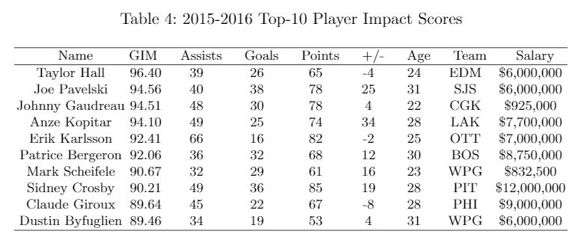
Goal Impact Metric
The Impact metric passes “eye test”.
Correlates strongly with goals, points, salary, etc. in NHL.
Consistent between and within seasons.
All actions including defensive and offensive actions.
Notes:
Why is GIM a good metric
All well-known top performers.
Various quantities of interest.
Convincing metric.
Defenseman Erik Karlsson appears on the top of the ranking.

Slide 8
Interpreting the DRL Model
Notes:
Remember our purpose is to interpret the DRL Model. In order to achieve this goal, I’ll introduce the Mimic Learning Method.

Slide 9
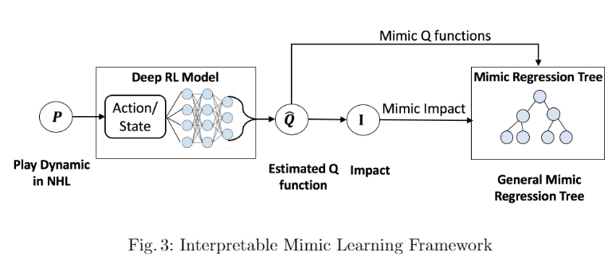
Model
Mimic Learning Framework for General Model:
Mimicking Q functions and impact separately.
History Window of last 10 observations.
A Multi-variate Regression Tree (MRT) trained with CART method.
Notes:
Q value and impact outputs from the previous DRL neural network.
Including a history window of length 10, we used them as inputs to Mimic Regression Tree.
(The history window is the last 10 observations.)
Although we mimicked Q and impact separately, the Q functions has three attributes (home, away, neither). It is actually a vector of size 3.
We should mimic them together. In order to do this, we chose to train a Multi-variate Regression Tree using CART method.

Slide 10
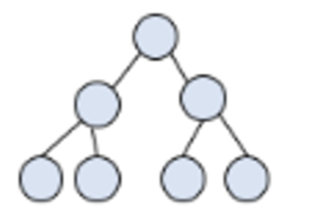
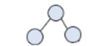
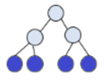
Model
Player Specific Model:
Inherit the tree structure of the general model.
Use the target player data to prune the general model.
Use the same player data to expand the tree.
initialize
General tree
prune
expand
Player tree
e.g. Sidney Croby
Notes:
For each player, we also built a player specific model.
The player specific model inherits the general model at first
Then we prune it use the target player’s data, then we found a problem that some trees don’t have enough depth.
(especially for exceptional players that differ a lot from the average)
3. So we expand the tree again use the same player’s data, and we get a special tree for each player.
(e.g Sidney Croby’s tree is like this, actually have more layers, just cannot display it)

Slide 11
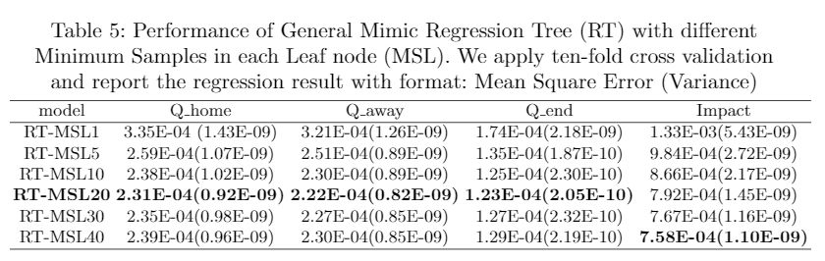
Model
DEL
Mean Sample Leaf (MSL):
Control the minimum number of samples at each leaf node.
Satisfactory performance when MSL = 20.
Notes:
1. In order to avoid over-fitting of the regression trees, we introduce MSL…
2. We test over MSL1-MSL40. We can figure out in the table that obviously MSL1 has problems of terribly over-fitting.
3. Finally we found…

Slide 12
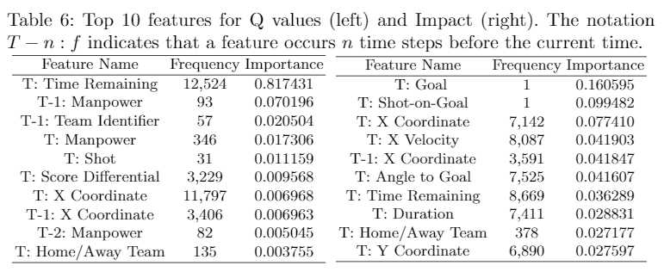
Feature Importance
Rank feature by average variance reduction:
Find the top 10 important features using general model.
The impact function recognizes shooting, successful actions.
History Window is necessary.
Notes:
For both Q values and impact
Time Remaining not so important at impact, since it has been cancelled out by the difference of Q.
Take the top 3 features as a whole, Goal, Shot-on-Goal (successful shot?) and X Coordinate (shot place).
Historical features appear (T-x) in the table.

Slide 13
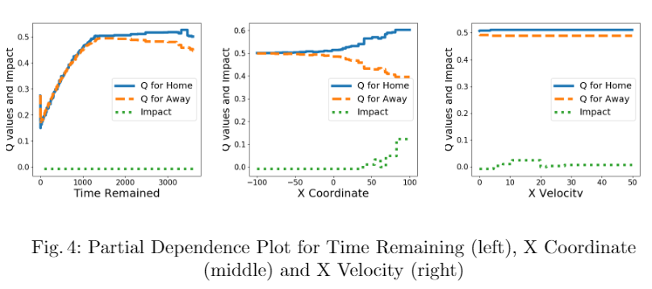
Partial Dependence
Partial Dependence plot:
Use general model to interpret Q functions and impact.
Select Time Remaining, X Coordinate and X Velocity to visualize.
Notes:
(Question from Oliver: why do you need a tree to do this? How about using the neural net. I don’t you need the mimic model for this.)
After calculating importance features, we wondered how these features are important, how will them influence Q-values and impact,
so we made Partial Dependence plot.
Time Remaining limited effect on impact (consistent with our findings for feature importance).
X Coordinate both effect on impact and Q (team is likely to score the next goal in the offensive zone).
Home advantage phenomenon (the home team is slightly higher than that of the away team).

Slide 14
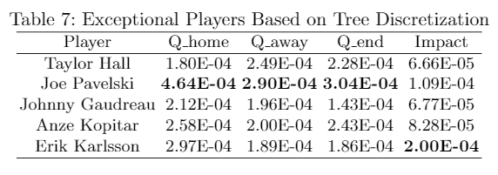
Exceptional Players
Find the most unusual players:
Use player specific model to compare the whole dataset (general data) and player specific data.
Joe Pavelski scored the most in the 2015-2016 game season.
Erik Karlsson had the most points (goal+assists).
Notes:
# Have backup slides for this.
1. Now we use player specific model to do something.
We all know that the general model represents the average performance of players, so we compared the player specific model with the general model to find the most unusual players.
2. Two players with the highest value in Table 7 stand out.
Joe Pavelski scored the most in the 2015-2016 game season, he has the largest Q value in the table.
Erik Karlsson had the most points, which is defined as goal plus assists, he has the largest impact in the table.

Slide 15

Thank You!
For more information:
Poster: #xxx
Homepage: http://www.galenliu.com/
Notes:
Thank you for your time and interest today!
Do you have any question about my work?

Slide 16

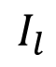

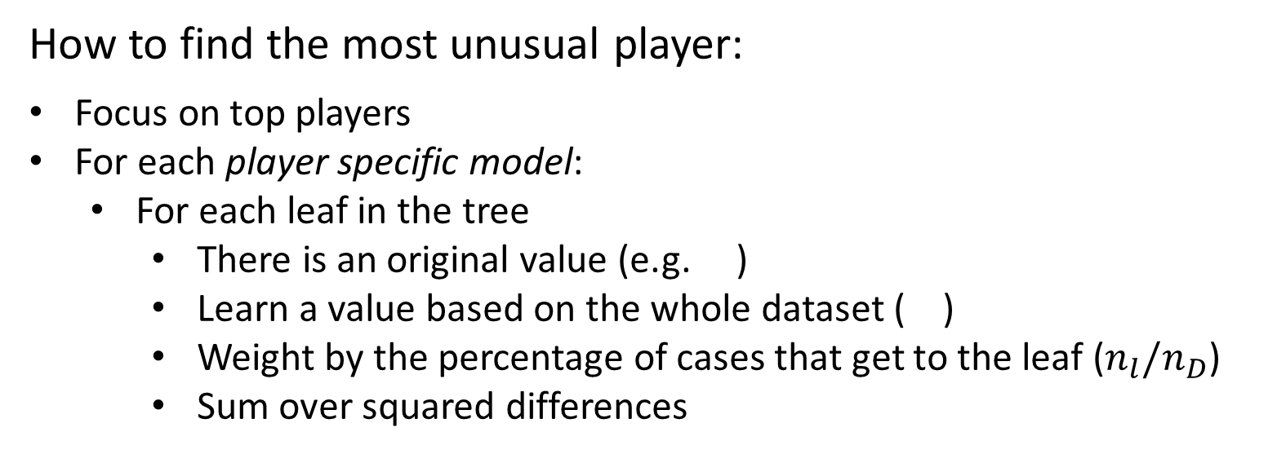
Exceptional Players
How to find the most unusual player:
Focus on top players
For each player specific model:
For each leaf in the tree
There is an original value (e.g. )
Learn a value based on the whole dataset ( )
Weight by the percentage of cases that get to the leaf ($n_{l}/n_{D}$)
Sum over squared differences
$$I_{l}^{P}$$
$$I_{l}$$
$${n_{l}/n_{D}\left(I_{l}^{P}−I_{l}\right)}^{2}$$
Notes:
1. Of course, we need to focus on top players, we want exceptionally good player, not exceptionally bad.
Now I’ll explain how we get these values for each player in the table, take the impact column as example.
We made a drill down analysis like this:
2. We have built a tree for each player, so in each leaf in the tree, there is a impact value I_P subscript L.
3, We input the whole dataset into the tree and learn a impact value I subscript L on each leaf.
4. Also, we weight the leaf by the percentage of cases that get into it amongst the whole dataset
5. Finally, we sum over weighted squared difference to get the value (Eg, Taylor Hall, 6.66E-05)
In this way, we find the most unusual player (farthest distance with average)

